Slide 1
Packages
A java package is a group of similar types of classes, interfaces and sub-packages.
Package in java can be categorized in two form, built-in package and user-defined package.
There are many built-in packages such as java, lang, awt, javax, swing, net, io, util, sql etc.

Slide 2
Advantage of Java Package
Java package is used to categorize the classes and interfaces so that they can be easily maintained.
Java package provides access protection.
Java package removes naming collision.

Slide 3
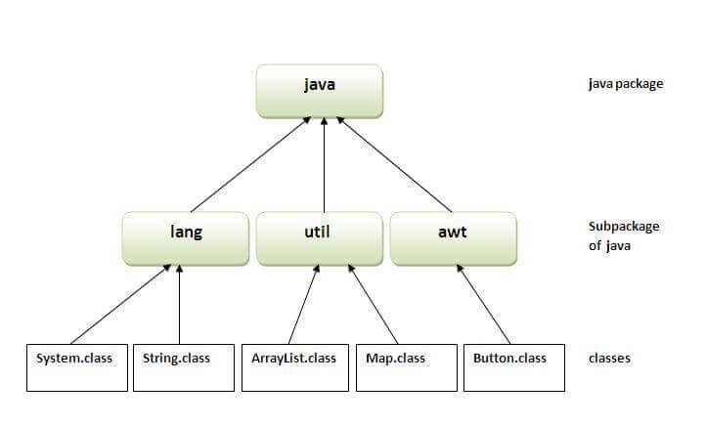

Slide 4
How to access package from another package?
There are three ways to access the package from outside the package.
import package.*;
import package.classname;
fully qualified name.

Slide 5
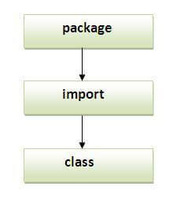
Sequence of the program must be package then import then class

Slide 6
Subpackage in java
Package inside the package is called the subpackage. It should be created to categorize the package further.

Slide 7
Java Static Import
The static import feature of Java 5 facilitate the java programmer to access any static member of a class directly. There is no need to qualify it by the class name.
Advantage of static import:
Less coding is required if you have access any static member of a class oftenly.
Disadvantage of static import:
If you overuse the static import feature, it makes the program unreadable and unmaintainable.

Slide 8
Access Modifiers in Java
There are two types of modifiers in Java: access modifiers and non-access modifiers.
The access modifiers in Java specifies the accessibility or scope of a field, method, constructor, or class.
We can change the access level of fields, constructors, methods, and class by applying the access modifier on it.
There are four types of Java access modifiers:
Private
Default
Protected
Public
Notes:
There are many non-access modifiers, such as static, abstract, synchronized, native, volatile, transient, etc.

Slide 9
Private: The access level of a private modifier is only within the class. It cannot be accessed from outside the class.
Default: The access level of a default modifier is only within the package. It cannot be accessed from outside the package. If you do not specify any access level, it will be the default.
Protected: The access level of a protected modifier is within the package and outside the package through child class. If you do not make the child class, it cannot be accessed from outside the package.
Public: The access level of a public modifier is everywhere. It can be accessed from within the class, outside the class, within the package and outside the package.
Notes:
There are many non-access modifiers, such as static, abstract, synchronized, native, volatile, transient, etc.

Slide 10
Understanding Java Access Modifiers
Access Modifier | within class | within package | outside package by subclass only | outside package
Private | Y | N | N | N
Default | Y | Y | N | N
Protected | Y | Y | Y | N
Public | Y | Y | Y | Y

